Slide 1

Qwen2.5-VL Technical Report
Radoslav Yankov
Technical University of Munich
Seminar Presentation
AI for Vision-Language Models in Medical Imaging
11.06.2025

Slide 2

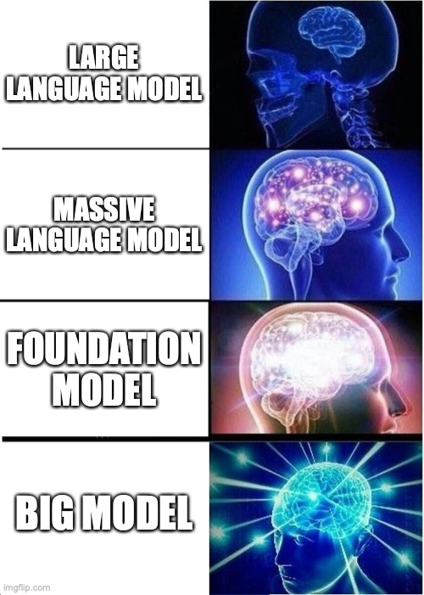
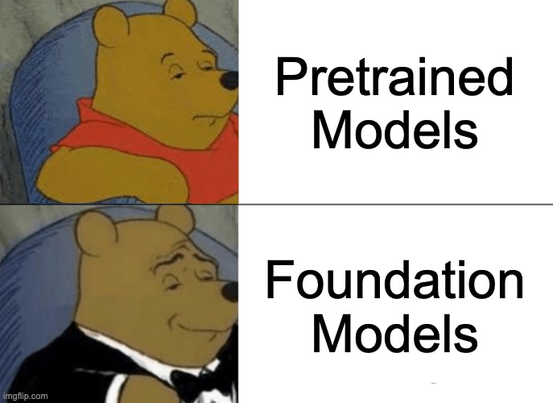
Foundation Models

Slide 3
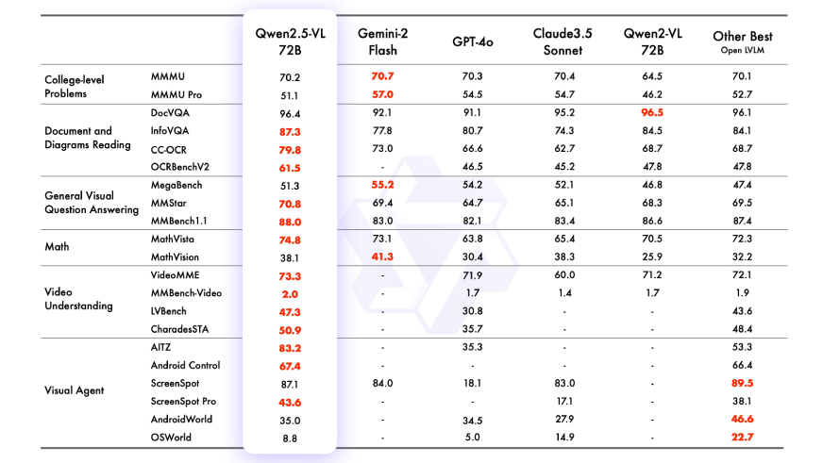
Exceptional Performance across multiple benchmarks and tasks

Slide 4
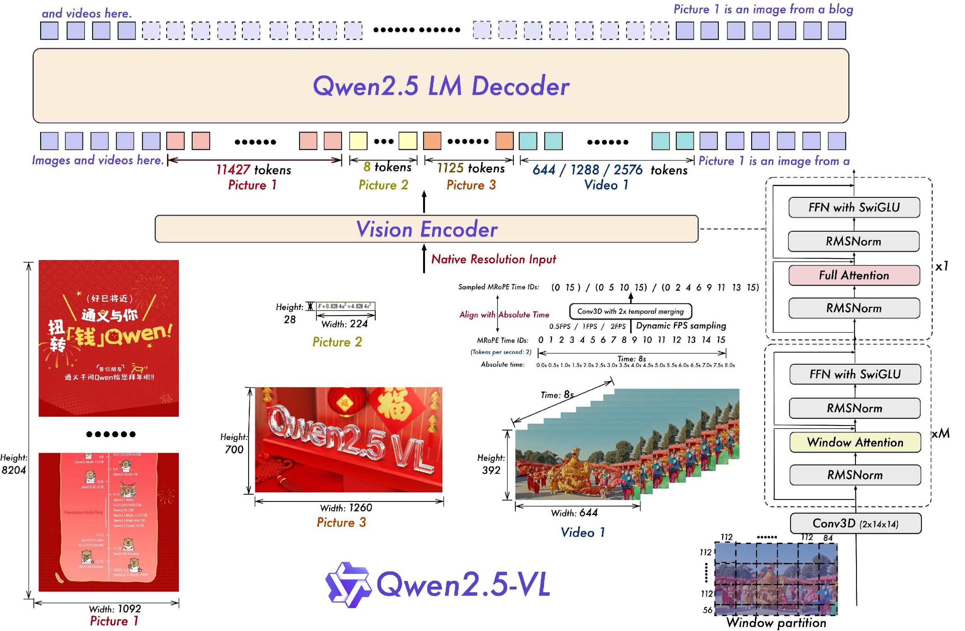
The Model
3 Main Components:
Visual Encoder
Cross-modal Projector
LLM – Qwen2.5
🏅Highlights
Document Parsing & OCR
Precise Object Grounding
Long-video Understanding (up to a few hours)
Enhanced Agent Functionality for the lightweight models
Available as 72B,7B, and 3B
Notes:
Recently 32B and also Max (235B)

Slide 5
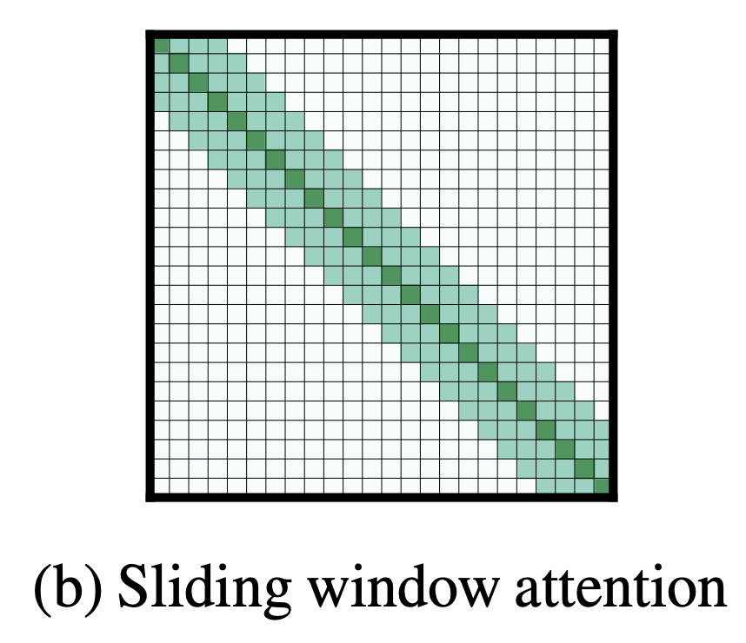
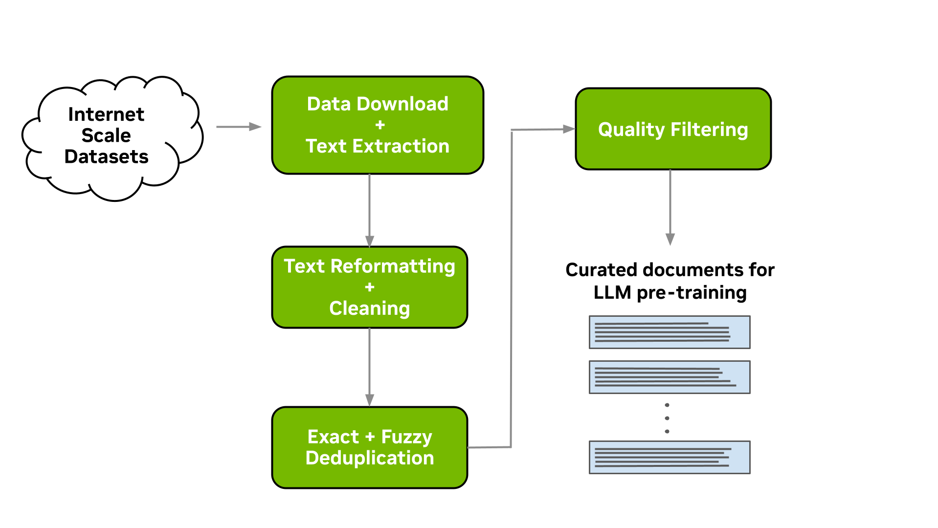
Contributions
🛠️Architecture and Technical Implementation
Window Attention in the Visual Encoder
Dynamic FPS Sampling
Upgrade MRoPE to include the temporal domain
🎨Data Curation – 4.1 trillion tokens of high-quality data

Slide 6

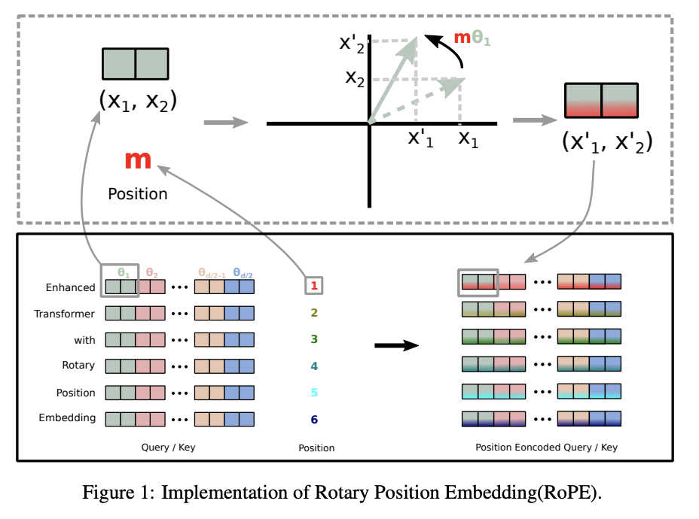
Vision Encoder
🏠 Based on a Visual Transformer (ViT)
2D RoPE and Windowed Attention
Window size – 112x112 (8x8 patches)
Only 4 layers with full self-attention
Faster Inference
⚙️ Able to process images at native resolution and videos with different frame rates
Video – 2 consecutive frames grouped together
MRoPE with 3 dimensions
Text all IDs identical
Images – time remains constant
Video – absolute time instead of # of frames
🦙 Alignment with LLM Architectures
RMSNorm
SwiGLU activation
🏋️ Trained from Scratch
Notes:
Encoder Training – CLIP Pretraining (LLM frozen), Vision-Language Alignment, End-to-end finetuning

Slide 7
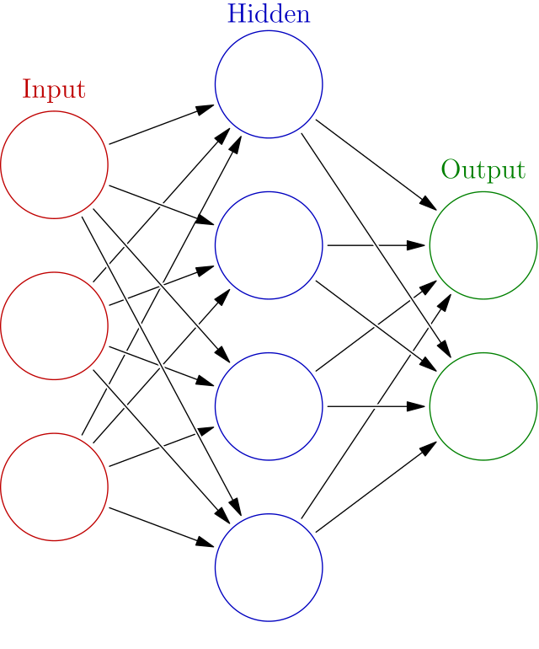
Crossmodal Projector Network
2 Layer feed forward neural network
Works on concatenated features of 2x2 image patches from the ViT
Brings the ViT features to the required dimension for the LLM decoder
Allows for dynamic compression of the inputs

Slide 8


Training Data
💪 4.1 trillion tokens
🧑‍🎨 Highly curated dataset of multimodal data ⚙️ Automated pipeline to assess data quality
🎯 Grounding data with absolute position coordinates – more than 10000 object categories
📄 Document Omni-Parsing – unified pipeline for tables, graphs, charts, figures, etc.
🔤 OCR Data – multilingual (real and synthetic)
📽️ Video Data – dynamic sampling at different frame rates
🤖 Agent Data – unified across platforms (PC/Web/Mobile)
Notes:
Data scoring based on text quality, image-text relevance, image text complementarity, information density balance Grounding – data also generated with models such as DINO and SAM – bounding boxes for objects

Slide 9
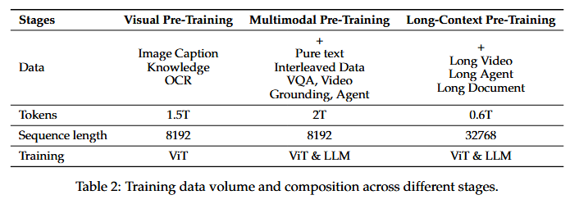
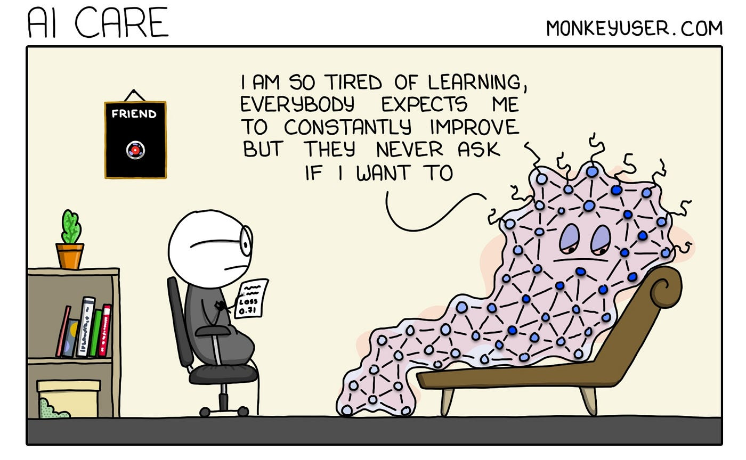
Training Recipe
Pre-Training
Post Training
Supervised Fine-Tuning
Direct Preference Optimization – image-text and pure text
ViT – frozen ❄️
2-stage Data Filtering Pipeline
Rule-based
Model-based
Rejection Sampling on complex tasks with CoT
Notes:
SFT - Instruction Following – 2 million entries (50% text & 50% multimodal)
Data Filtering – Domain Categorization with Qwen2-Instag followed by domain specific filtering for rule-based – remove duplicates and redundancies
For model-based reward based models keep only samples with high value
Rejection Sampling based on an intermediate version of Qwen2.5-VL

Slide 10
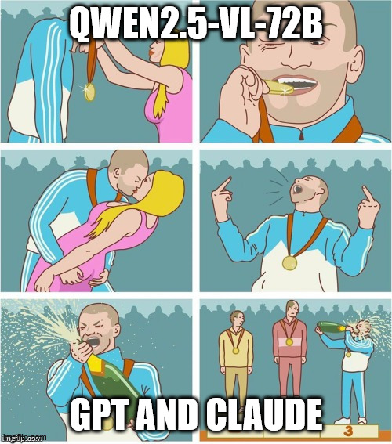
Results
Direct Competitions
GPT-4o-051 and Claude-3.5-Sonnet-0620
🖼️ Multimodal Performance
Competitive in math-related questions
Excels in visual QA
Especially good in high-resolution benchmarks
📄 Text only – competitive performance versus Llama
🔤 SoTA in OCR 🏆
🎯 Competitive in spatial understanding and object grounding
📽️ Excellent video understanding and grounding performance
🤖 Competitive agent capabilities

Slide 11
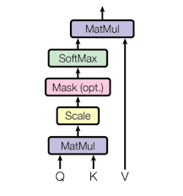
Thank you for your 😊
Questions?

Slide 12
Sources
Qwen2.5-VL Technical Report - https://arxiv.org/pdf/2502.13923
RoFormer: Enhanced Transformer with Rotary Position Embedding - https://arxiv.org/abs/2104.09864
GLU Variants Improve Transformer - https://arxiv.org/pdf/2002.05202

Slide 13
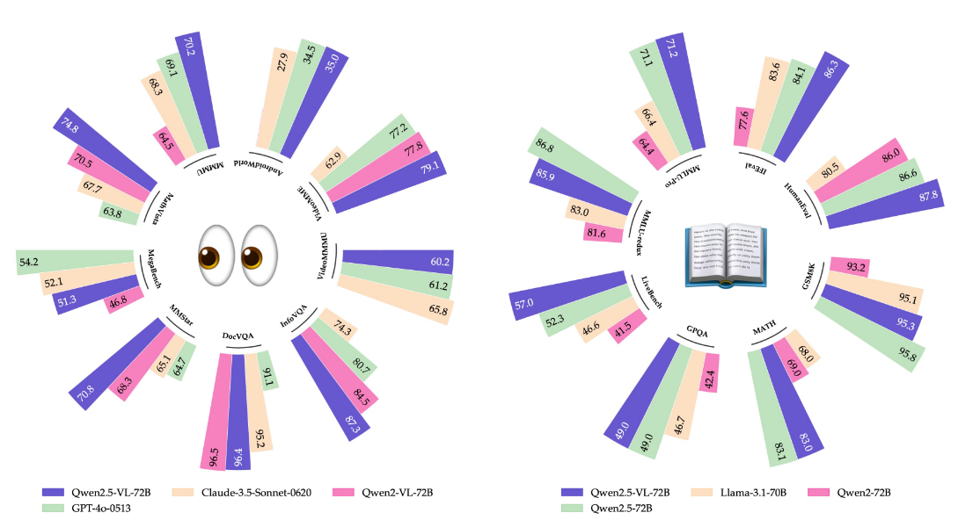
Appendix - Results

Slide 14
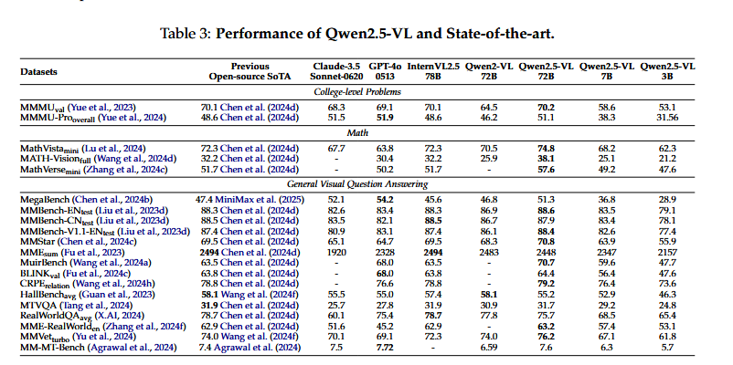
Appendix Results

Slide 15
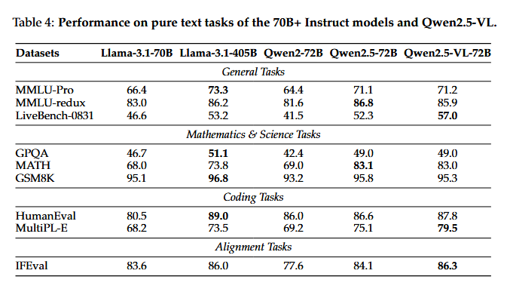
Appendix Results

Slide 16
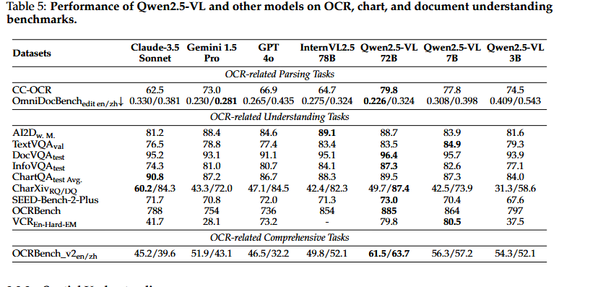
Appendix Results

Slide 17
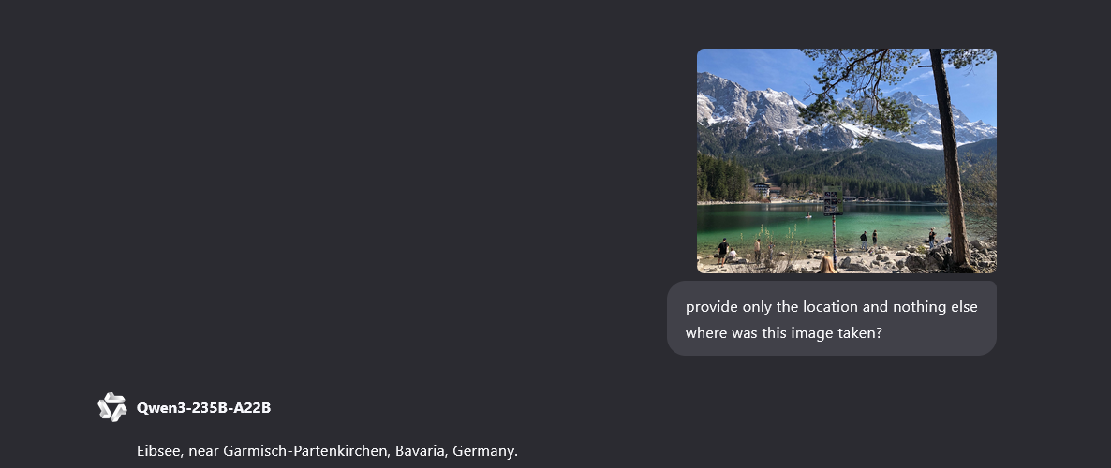
Appending Results

Slide 18
Appendix RoPE
Rotary Positional Encodings
2D tuples of key value (x, y) are rotated with 2D rotational matrices
Relative instead of absolute position
Better generalization for longer sequences (also sequences longer than those seen in training)

Slide 19
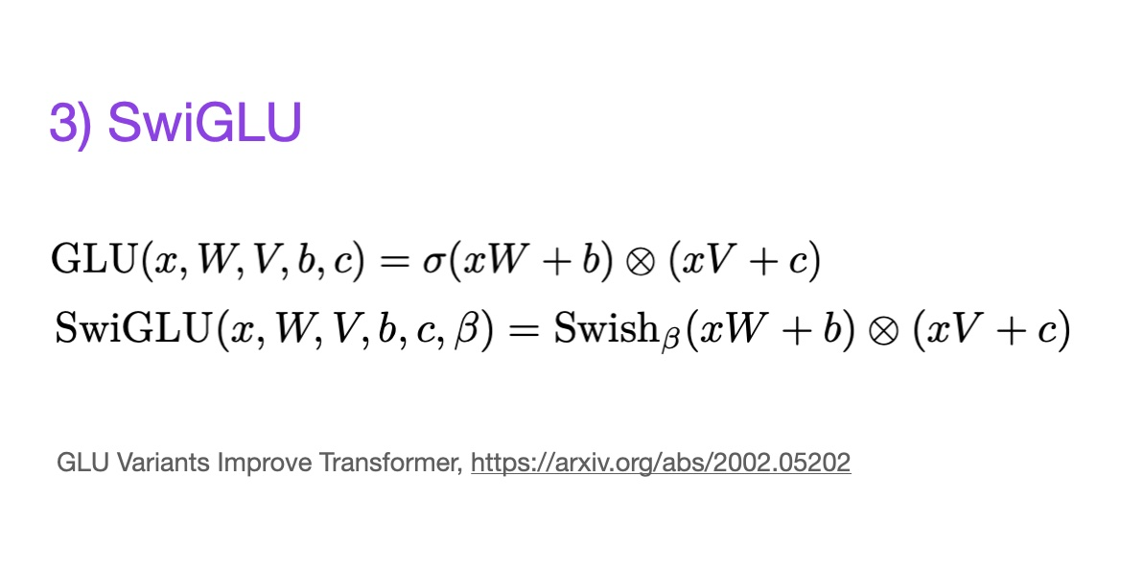
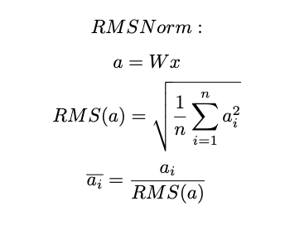
Appendix SwiGLU and RMSNorm

Slide 20
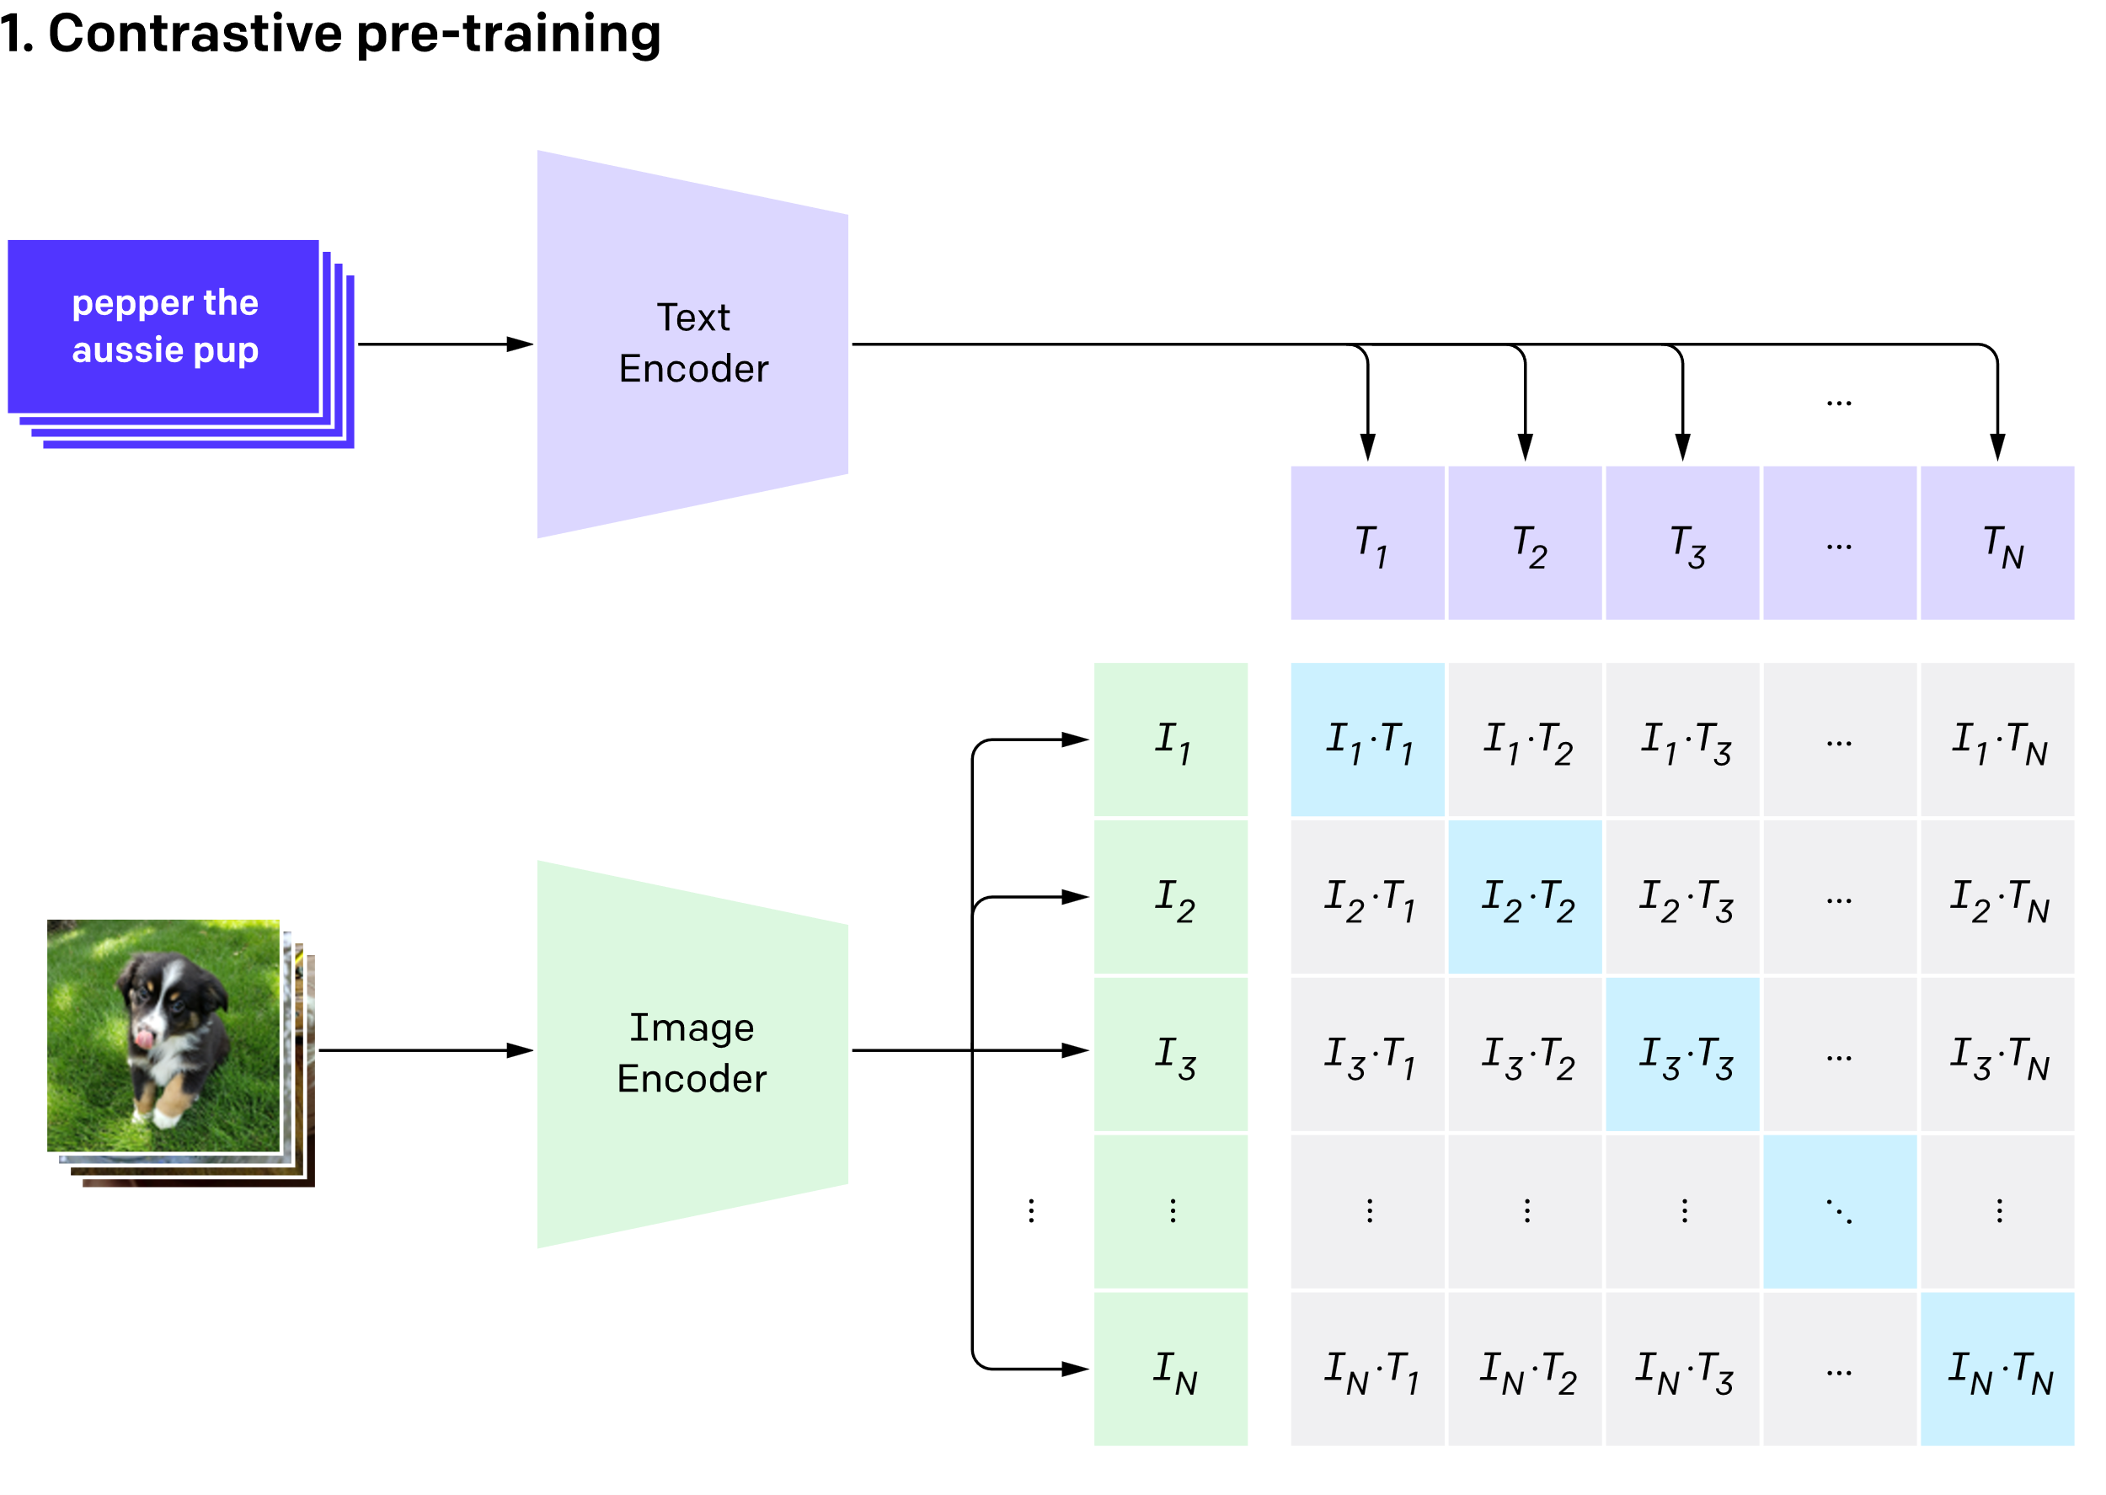
Appendix CLIP

